Slide 1
Welcome to
Notes:
1. Table of contents
2. Introduction
3. Our company
4. Our team
5. Problem
6. Them vs. us
7. Solution
8. SWOT analysis
9. Product overview
10. Our plans
11. Product demo
12. Traction
13. Case study
14. Reviews
15. Awards
16. Market size
17. Target
18. Competitors
19. Business model
20. Timing
21. Predicted growth
22. Investment

Slide 2
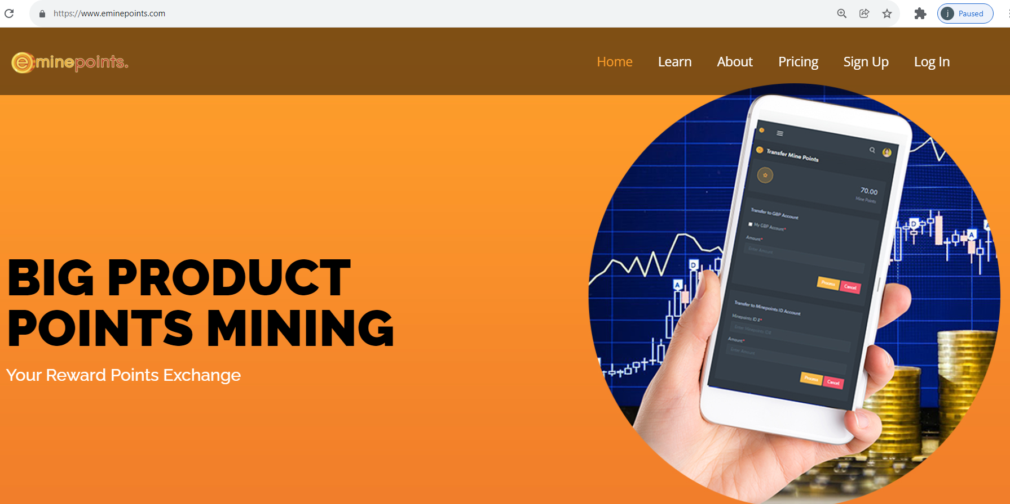
Introduction
Emine points Website
www.eminepoints.com

Slide 3
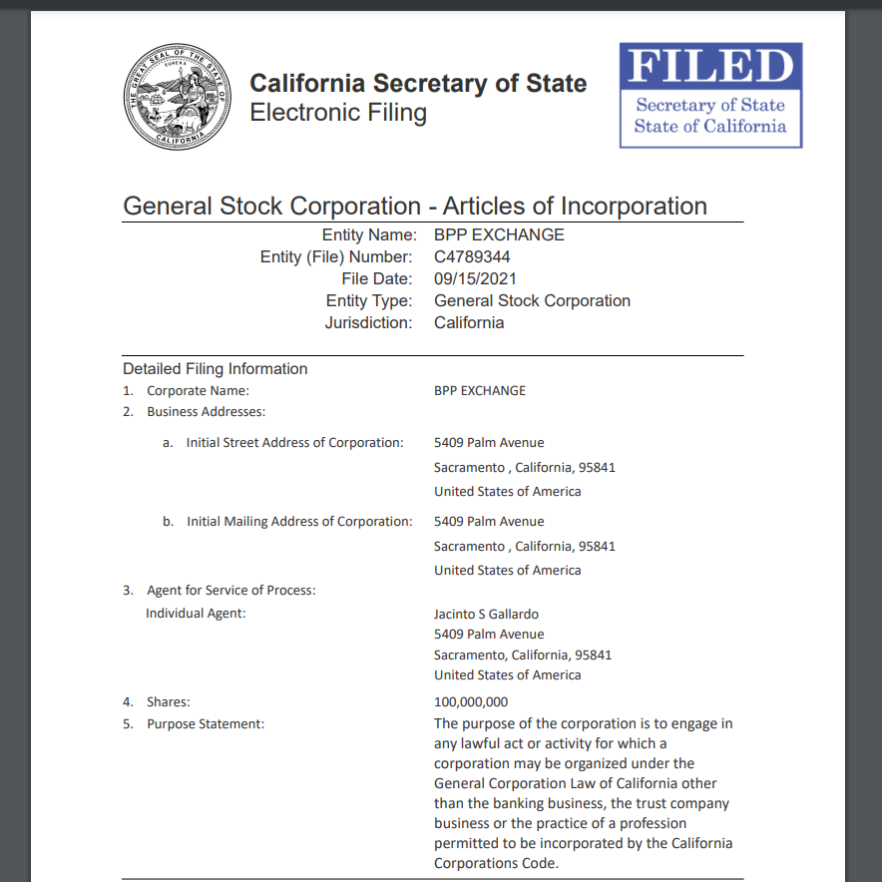
Our Company
BPP EXCHANGE CORPORATION IS A STOCK MULTI- MILLION DOLLARS START-UP ADVERTISING COMPANY

Slide 4
It is a registered stock corporation in the state of California, USA.

Slide 5
What is E-MINE POINTS?

Slide 6
E-MINE POINTS
Is a centralized cloud computing platform, a program designed to extract and manage all reward points issued by merchants to customers.

Slide 7
E-Mine Points Technology is a system wherein every single loyalty reward point issued by the merchants will not go to waste! But it will instead become valuable, profitable and beneficial to consumers.

Slide 8
How E-MINE POINTS works?

Slide 9
Step 1
Sign Up the Subscription Plan: Browse: www.eminepoints.com
You will receive username and password via email or sms once your acccount is activated.

Slide 10
E-MINE POINTS Pricing

Slide 11
Click Pricing Menu

Slide 12
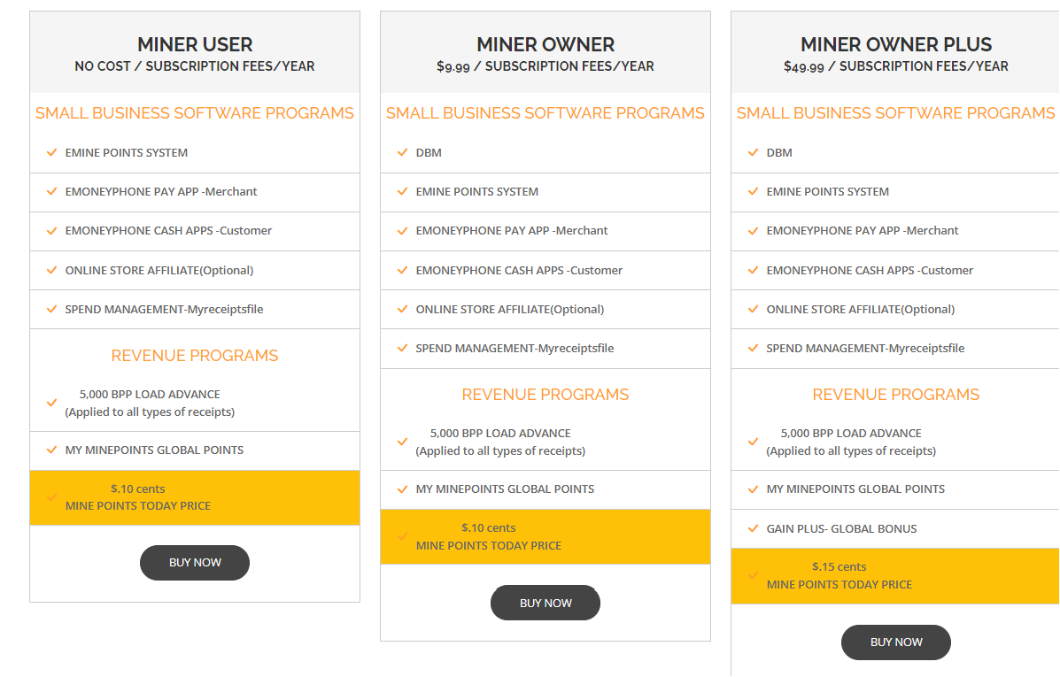
E-Mine Points Subscription Plan

Slide 13
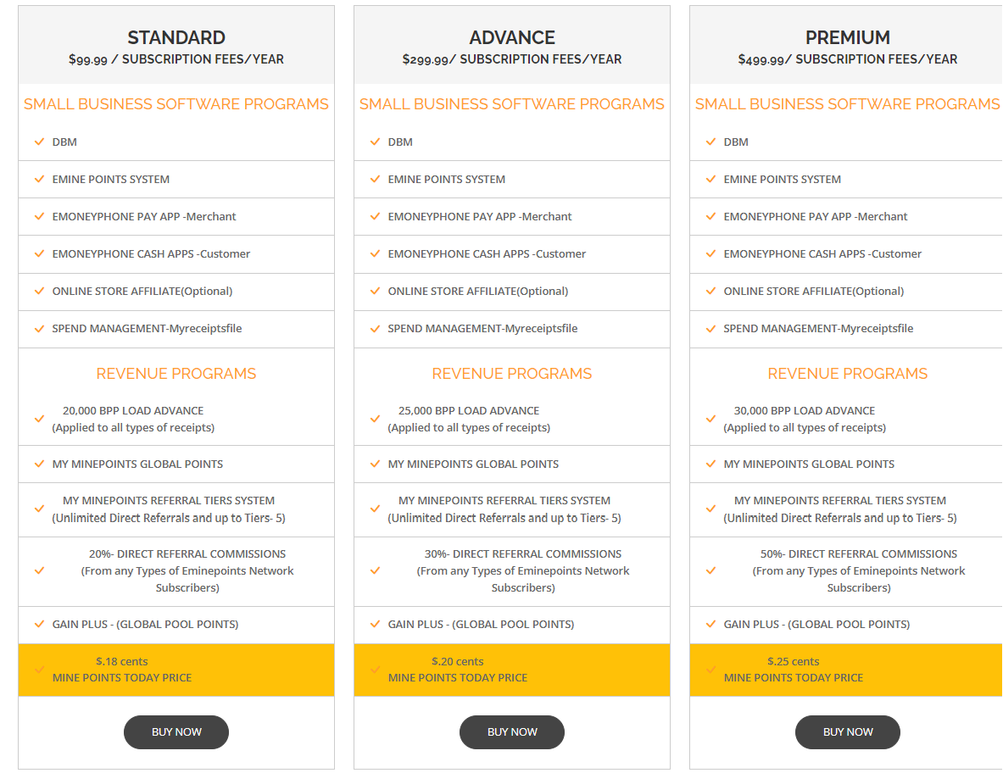
E-MINE POINTS NETWORK Subscription Plan

Slide 14
Step 2
Login to your eminepoints dashboard

Slide 16
You will see your daily Minepoints Credit Here

Slide 17
WHAT IS GLOBAL POINTS EXCHANGE
(GPEX)?

Slide 18
GLOBAL POINTS EXCHANGE
CENTRAL
BUYER
GPEX
SELL BPP TO MERCHANTS

Slide 20
HOW GPEX WORKS?

Slide 21
Step 1
Sell your Mine Points anytime to GPEX. You will see today’s Price per eminepoint.

Slide 22
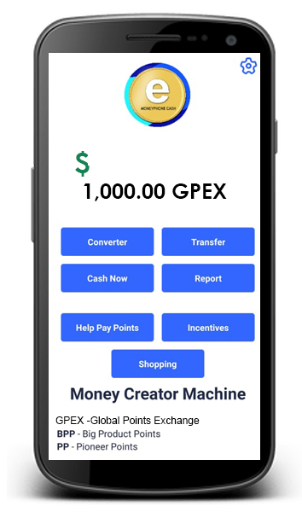
Step 2
You will see your Global Points Exchange Transactions in Emoneyphone Cash Apps that includes eminepoints you sell.

Slide 23
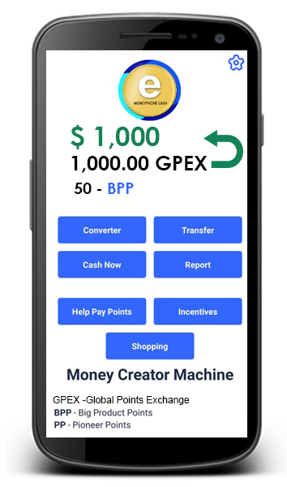
Step 3
Click Converter Button, convert your GPEX Points credit into cash. 1 GPEX point is equivalent to $1 US Dollar Cash Value

Slide 24
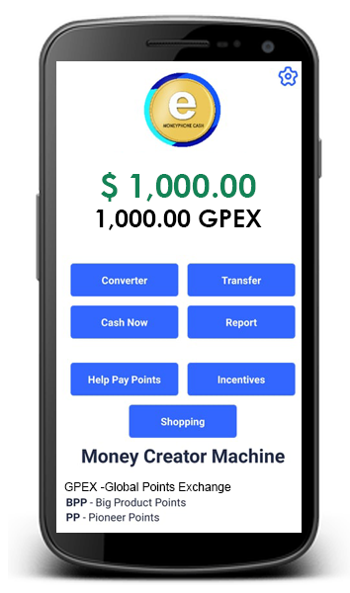
Step 4
Click Cash Now Button, and get your cash from pay out option worldwide.

Slide 25
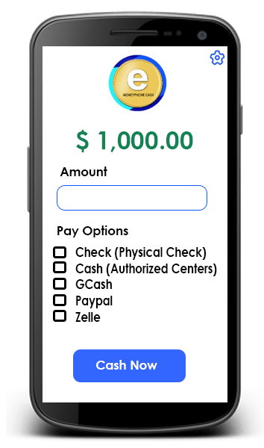
Select any pay out options in your convenience

Slide 26
See your Potential Cash Bonuses

Slide 27
ILLUSTRATION (Potential Cash Bonus Rewards) E-Mine Points Network
TYPES MINER SOFTWARE | STANDARD | ADVANCE | PREMIUM
Subscription fees (yearly) | $199.99 | $399.99 | $499.99
1. Direct Referral Commissions (from any of miner’s network fees) | 30% | 40% | 50%
2. Indirect Tiers Global Mine Points
Tier-1 (5 Direct Referrals and Earned 10 Points Credit Each Miner ) | 50 | 50 | 50
Tier-2 | 250 | 250 | 250
Tier-3 | 1,250 | 1,250 | 1,250
Tier-4 | 6,250 | 6,250 | 6,250
Tier-5 | 31,250 | 31,250 | 31,250
Total E-Mine Points Network | 38,800 | 38,800 | 38,800
GPEX Today’s Price | $0.18 cents | $0.20 cents | $0.25 cents
Cash Bonus Rewards | $6,984 | $7,760 | $9,700

Slide 28
ILLUSTRATION (Potential Cash Bonus Rewards) E-Mine Points
TYPES MINER SOFTWARE | MINER USER | MINER OWNER | MINER OWNER PLUS
Subscription fees (yearly) | NO COST | $9.99 | $49.99
GROUP GLOBAL BONUS POINTS
Group-1 ( Register 4 direct miners in which you will earn a minimum of 5 points each miner every month. | 20 | 20 | 20
Group-2 | 40 | 40 | 40
Group-3 | 160 | 160 | 160
Group-4 | 640 | 640 | 640
Group-5 | 2,560 | 2,560 | 2,560
Group-6 | 10,240 | 10,240 | 10,240
Group-7 | 40,960 | 40,960 | 40,960
Total E-Mine Points | 44,370 | 44,370 | 44,370
GPEX Today’s Price | $0.10 cents | $0.10 cents | $0.15 cents
Cash Bonus Rewards | $4,437.00 | $4,437.00 | $6,655.50

Slide 29
HOW TO SELECT YOUR PLAN?

Slide 30
Step 1: Click Sign Up button

Slide 31
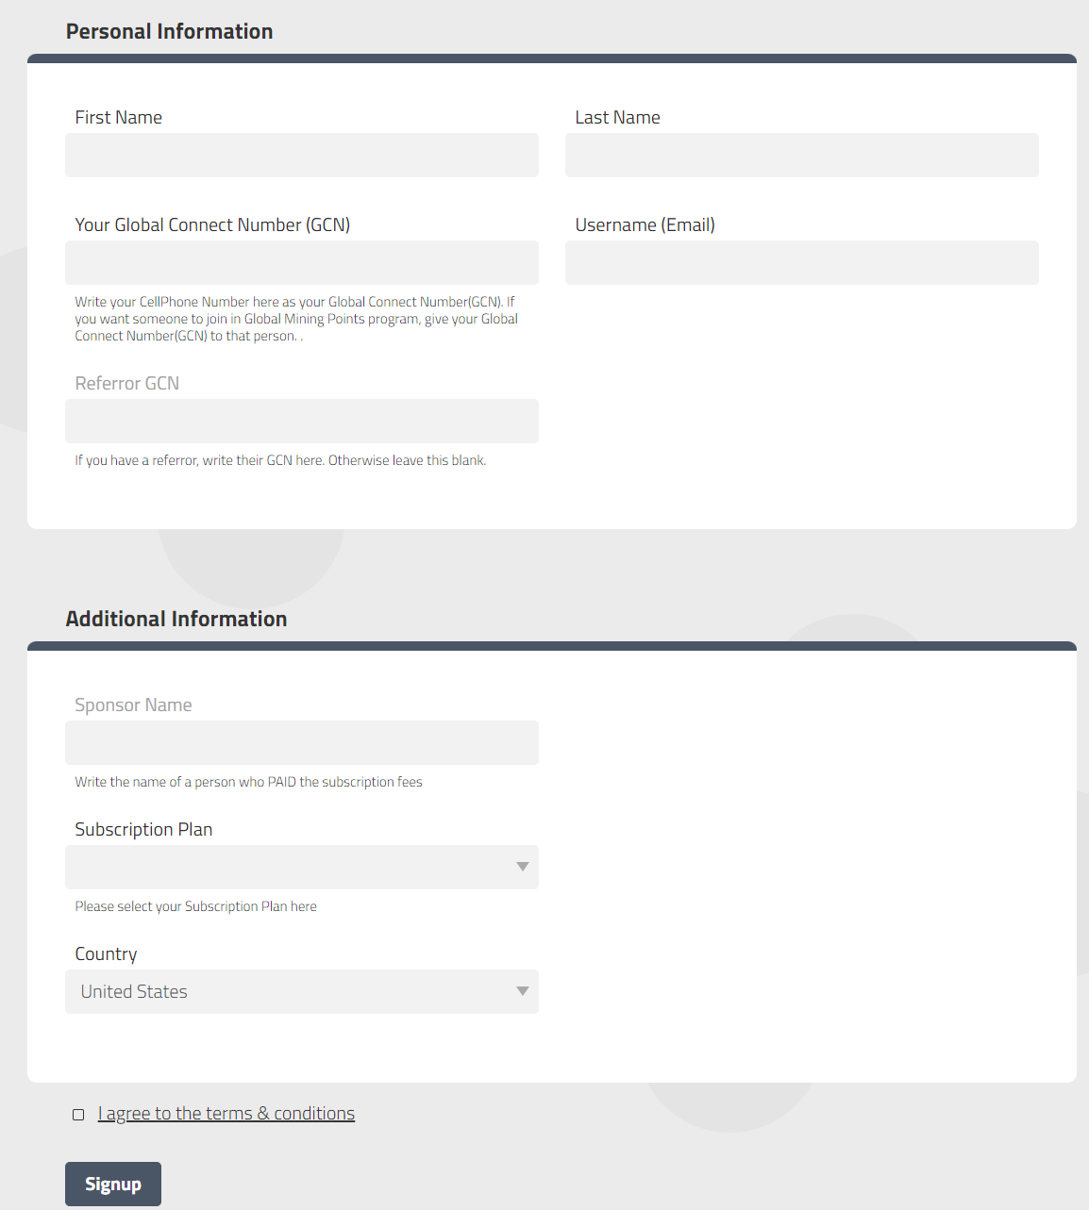
Fill Up the Sign Up Form & Select your Plan TWO TYPES OF SUBSCRIPTION PLAN Sponsor Paid- No Cost from you. Self Paid- Pay by yourself

Slide 32
Step 2 : Click Pricing button

Slide 33
Select your Plan and Pay – Eminepoints Subscription Plan

Slide 34
Select your Plan and Pay – Eminepoints Network Subscription Plan

Slide 35
HOW to LOGIN TO YOUR EMONEYPHONE PAY APP? (For Android Only)

Slide 36
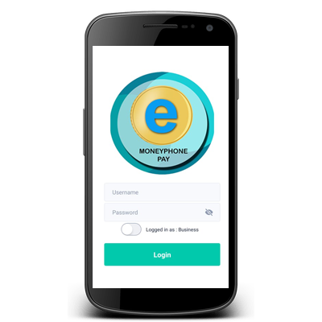
1. Download Emoneyphone Pay App

Slide 37
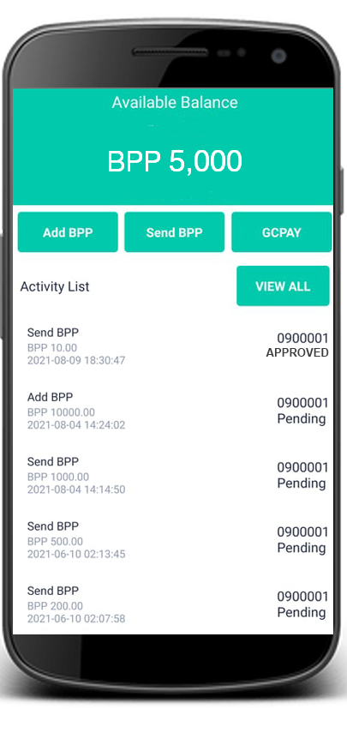
2. CLICK SEND BPP BUTTON TO SEND BPP LOAD.

Slide 38
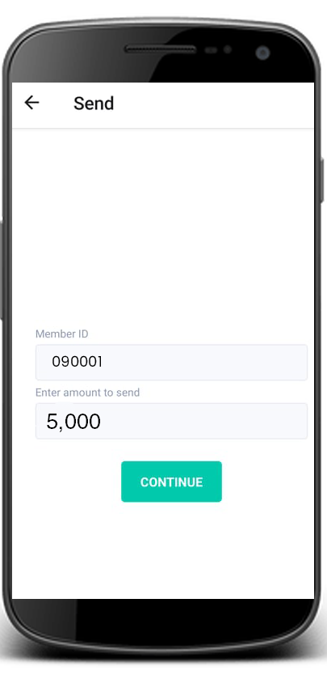
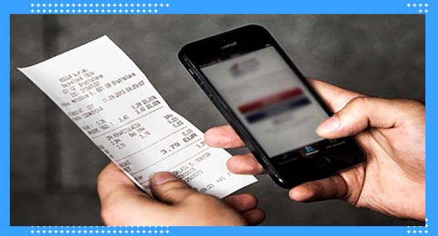
2. CONSUME YOUR BPP ADVANCED LOAD BY RECORDING ALL EXPENSES OR RECEIPTS
Total Expenses
P5,000

Slide 39
3. You will see your earned points from your Emoneyphone Cash app real- time
100-BPP

Slide 40
4. You will see minepoints here

Slide 41
THANK YOU!
Visit us at www.eminepoints.com

